Slide 1
Credit Card Rewards Analysis

Slide 2
Objective
Maximize cash back by examining Clients spending and projecting cash back with other popular rewards cards

Slide 3
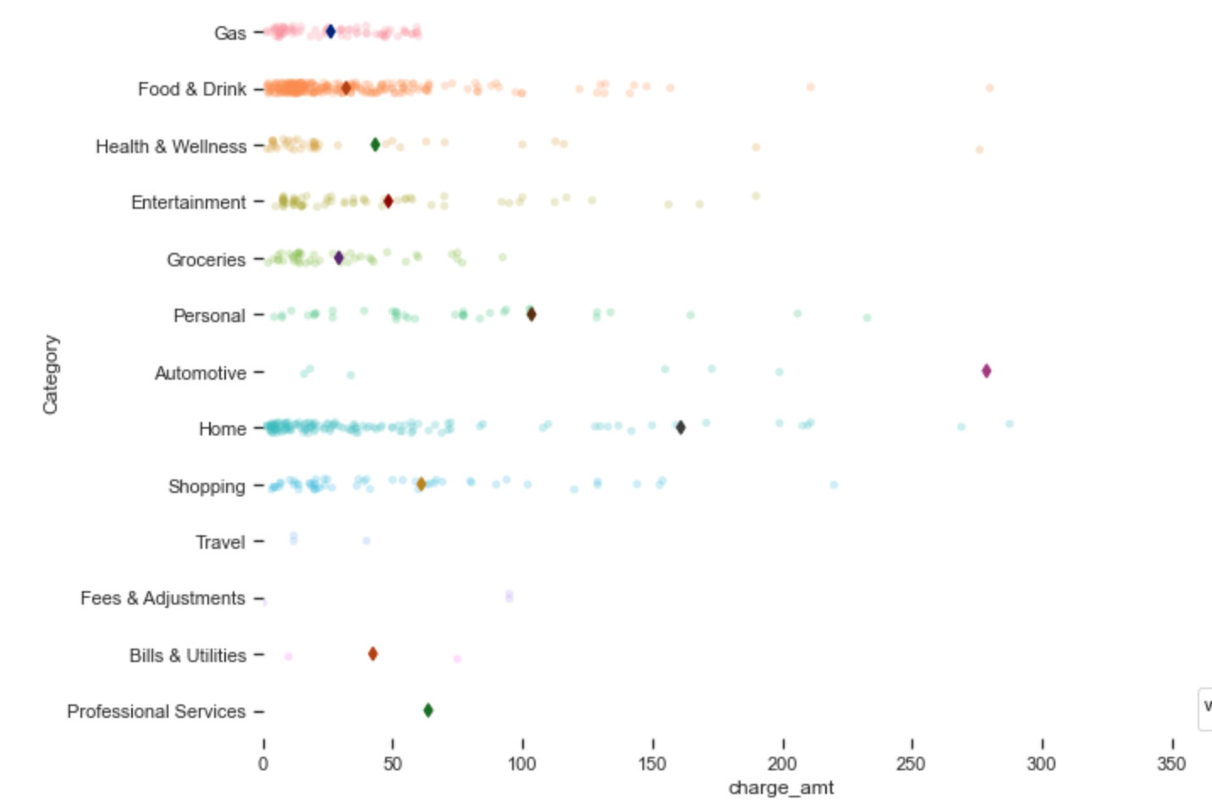
Overall Spending on Current Card

Slide 4
Potential Savings – 150-200/year
Shop exclusively at Lowes (instead of HD) and use Lowes Card for Lowes purchases
Cancel current card and move Grocery & Dining spending to Capitol one Venture One card

Slide 5
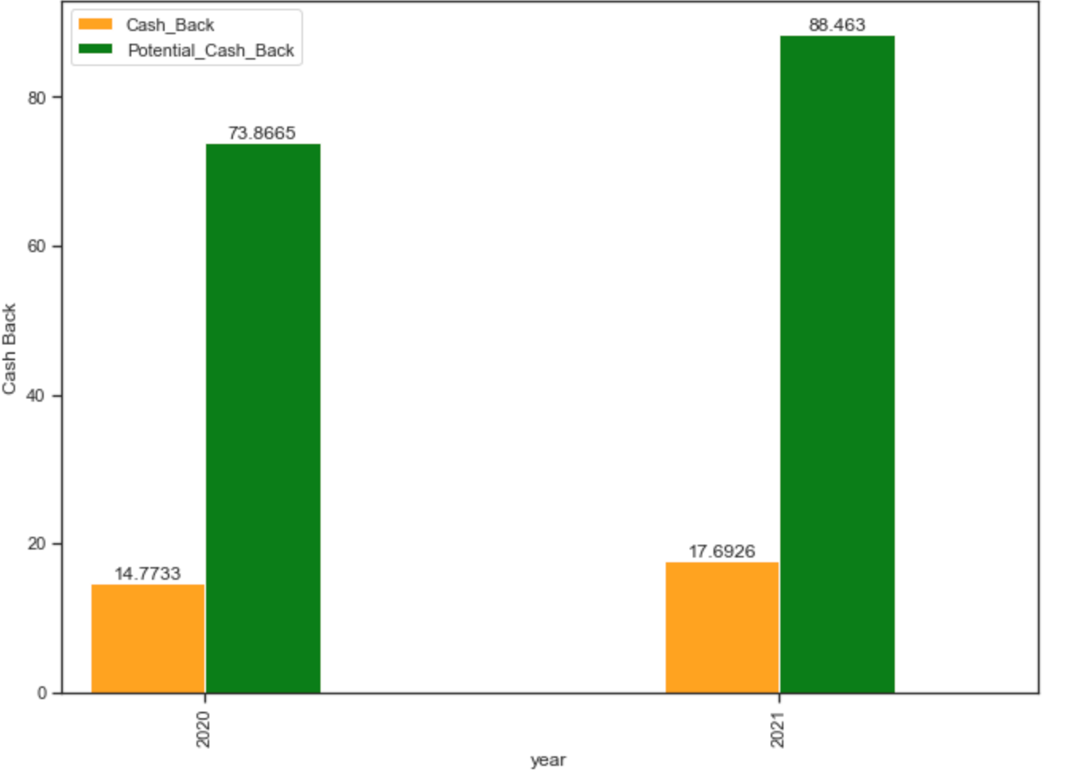
Lowes Savings

Slide 6
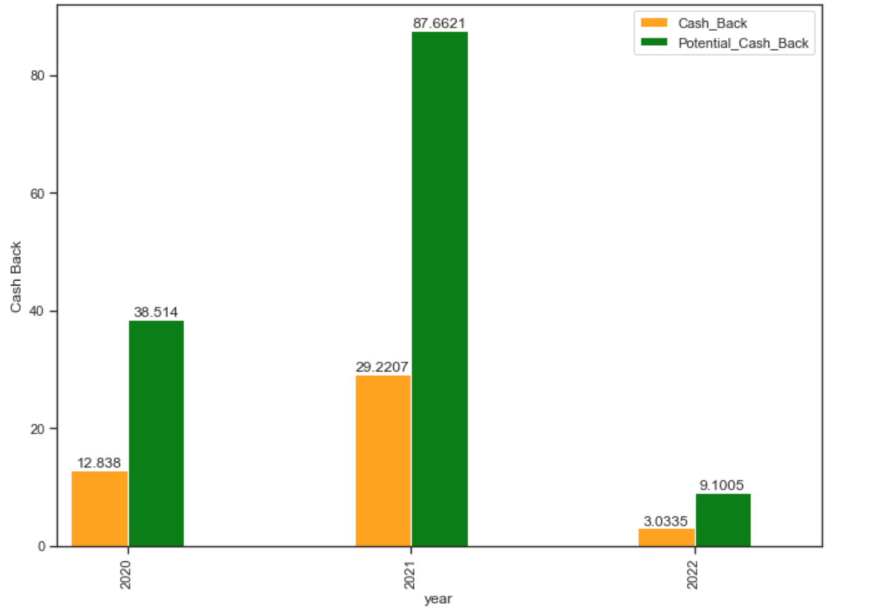
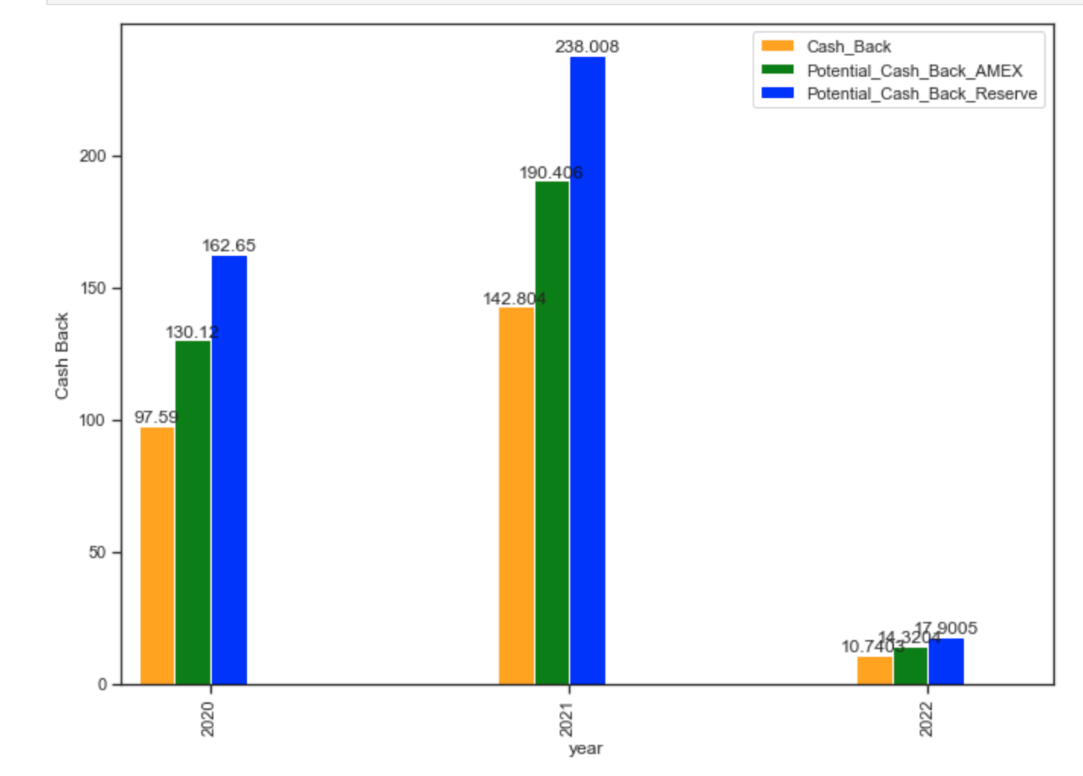
Grocery & Dining Savings
Grocery is left, Dining right. Current card does not support 100 dollar annual fee for 3 percent on Dining (Capitol One Venture One has no annual fee)

